Slide 1
Identifying the Best Location to start an Indian Restaurant

Slide 2
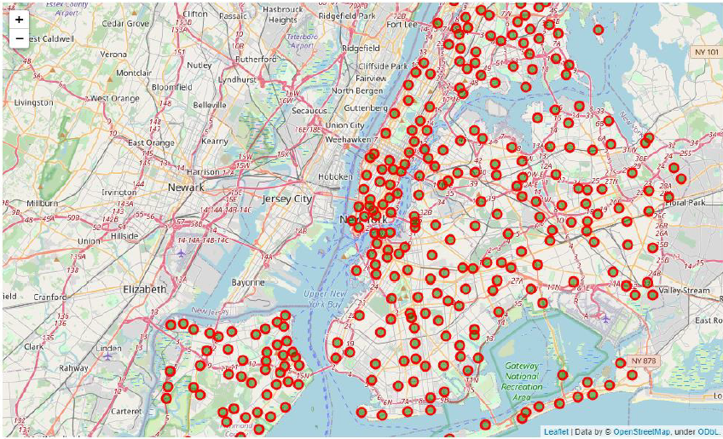
Introduction
Problem New York City (NYC) is a metropolitan city that offers a lot of opportunities for Asian cuisine. However, It can be daunting to choose a potential location given the huge variety of choices.
Objective Recommend locations in NYC to start new Indian Restaurant
Criteria 1. Areas that are densely populated with restaurant 2. Areas that are having low Indian restaurant density 3. Areas with high population and growth
Expected Outcome Narrow the search for businesses with specific good recommendations to start an Indian Restaurant

Slide 3
Data
http://cocl.us/new_York_dataset (List of neighbours in NYC)
https://data.cityofnewyork.us/ (Geospatial and population data in NYC)
Foursquare API (Venues in the NYC neighbourhoods)
There is a total of 5 Boroughs and 306 Neighborhoods in New York. And there are about 147 indian restaurants across New York based on Foursquare classification.

Slide 4
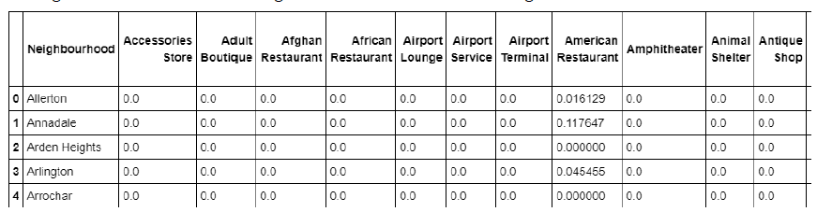
Methodology
Data will be extracted through various API calls
Data cleaning and wrangling will be done to explore the data
Data visualizations and mapping of the favourable locations such as Manhattan and Brooklyn.
Scoring of the criteria performance for each neighbourhood
Clustering and visualizations of the neighbourhoods
Example of venues in neighbourhood

Slide 5
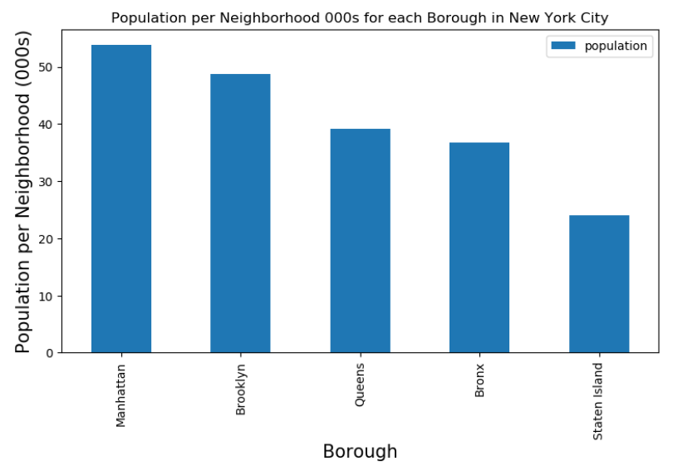
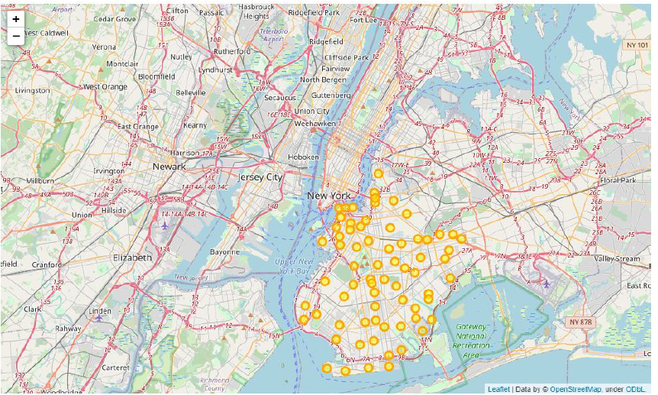
Results
Recommended Boroughs are Brooklyn and Manhattan as top priority which aligns with clusters 4 and 1 from the clustering analytical results.
Specific neighbourhoods are Manhattan Beach, Brooklyn and Ditmas Park, Brooklyn which has low Indian restaurant density amidst a neighbourhood that has more restaurants and also an expanding population.

Slide 6
Discussion
The results provides a screened top list of recommendations for businesses that are keen to set up Indian Restaurants in New York.
These insights derived from the analysis helps to narrow down the search and save costs for business owners to conduct further more specific market penetration tests.
Further analysis such as street surveys are critical to obtain more consumer validation of the business potential.
The analysis could be more extended to include more granular details of demographic variety in each Neighborhoods or the tourists that are visiting the neighborhoods to complement the location-based analysis that is conducted during this research

Slide 7

Conclusion
There is potential to start Indian Restaurant in Brooklyn and Manhattan as first priority.
The recommendations are derived after achieving all the criteria that defines what would a good location be: high population and growth, low Indian restaurant density and high restaurant popularity.
There is definitely a huge potential to open more Indian restaurant in these NYC Boroughs and Neighborhoods.

